Slide 1
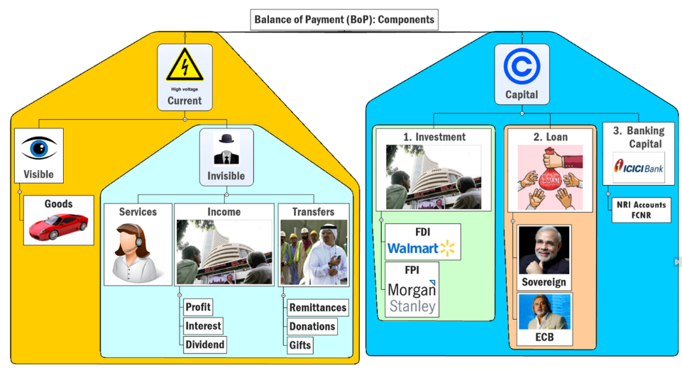

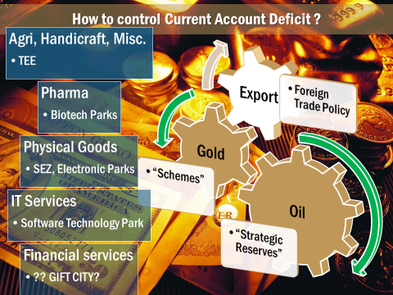
Convertibility
Exchange Rate
Sterilization
Forex Reserve
CURRENT
CAPITAL

Slide 2




Foreign investment
FPI
FDI
>10% Equity Investment
ADR/GDR: American/ Global Depository Receipts
FII, QFI, FVCI (Venture), NRI
Foreign Currency Convertible Bonds or FCCBs
Notes:
Colors of the logo

Slide 3

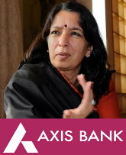


Foreign investment Limit= “FDI+FPI Composite Cap” in all sectors Except…..
FPI: Max. 24%
FPI: Max. 49%
Notes:
Axis, yes bank
Bank, Defense
Defense: overall 49%, FPI max. 24%
Pvt. Banking: overall 74%, FPI max 49%
Others
Composite cap
NFBC 100% (any composition of FDI+FPI)

Slide 4

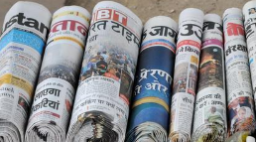

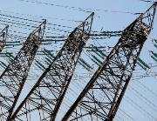







Foreign Investment (FDI+FPI) Limits in India
Prohibited
Lottery, Chit funds, Nidhi fund
49%
Betting, Gambling, Tobacco
Real estate business**
Farmhouse
Atomic energy.
Railway transport (Metro permit)
B2C E-commerce :Inventory based
20-26%
PSU-Petro Refine; Power-exchange
Defense (FPI-24%); private security agencies
Cable, Airlines
Insurance; Pension; Commodity exchange
26% Print Media, FM Radio
Public Sector Banks- 20% MAX
GST+ Central Excise

Slide 5


Foreign Investment (FDI+FPI) Limits in India
51%
74%
Multi-brand Retail
30% procurement from local sources,
metropolitan areas only
Selected states permitted
Private Banks (49% FPI MAX)
Broadcasting: DTH, Mobile TV, Satellite
Credit info. companies

Slide 6


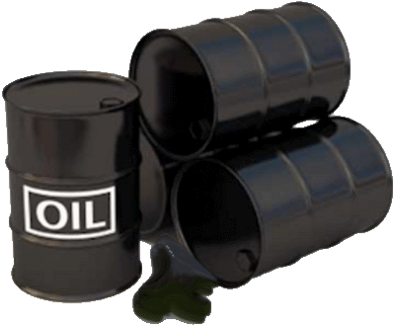




Upto 100% Equity Foreign investment permitted in
Agri, Animal
Agriculture (Tea- Government route)
Manufacturing; Industrial Parks; Railway-infra
Mining, coal
[low cost] Housing, construction*
Oil gas exploration
Airport Greenfield, brownfield; helicopter, Courier
Pharma Green field; Brownfield; ,Medical devices
NBFC, ARC –SARFAESI; White-label ATM
Sci-magazine, journals
Wholesale trading, single brand Retail, B2B-Ecomm, Market place-Ecomm

Slide 7

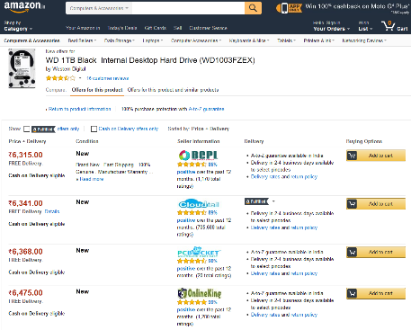

Foreign investment in E-commerce; WEF 2016
Foreign investment prohibited
100% automatic permitted
Inventory based E-commerce
Company owns inventory of goods, sells to consumers directly
Marketplace based E-commerce
Company provides IT platform to facilitate deal between buyer and seller
Notes:
Criticism
What if 25% norm violated by multiple shell firms?
Norms require company to make ‘level playing’ field among sellers; But what if one of them is giving deep discount?

Slide 8
FDI: Sector wise- last 15 years trend
Services
Computer Hardware, software
Construction
Telecom
Automobile
Decreasing order
Singapore
Mauritius
Netherland
USA
Round Tripping, DTAA-CGT
[Ref: blackmoney lecture]
Notes:
Highest services=.

Slide 9

Private Commercial bank: 49% “Automatic”; 74% “approval”
Same dept. that makes
Budget, Survey & SSS
Upto 5k cr
Cabinet Committee on Economic Affairs (CCEA)
FIPB
5k >
90s: Initially under PMO (300 cr.)
Transferred to DIPP
Then to FinMin (2003)
Boss: Secretary (IAS) DEA +MEA, DIPP et al.

Slide 10
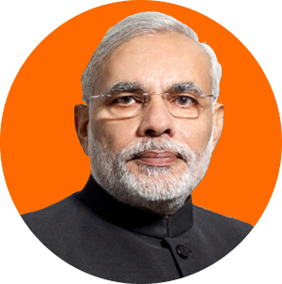
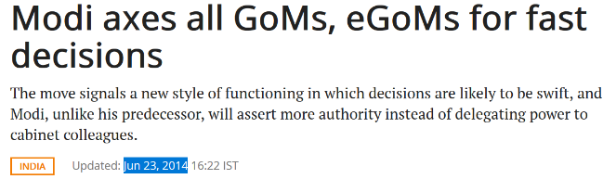
Decision Making @Top Level
Cabinet: Standing (6)
1) Security: PM
2) Appointments: PM
3) Political Affairs: PM
5) Parliamentary Affairs: HM
6) Accommodation: HM
Cabinet: Ad Hoc
Temporary, As and when required
GoM & EGoM
3G Auction terms, Food security Act, Drought problem etc.
4) Economic Affairs: PM
@local level: “Participation”, “decentralized Decision Making ” की पिपुड़ी बजाना ठीक है, लेकिन,
@National level: centralization, same reason why “BAD BANK”

Slide 11

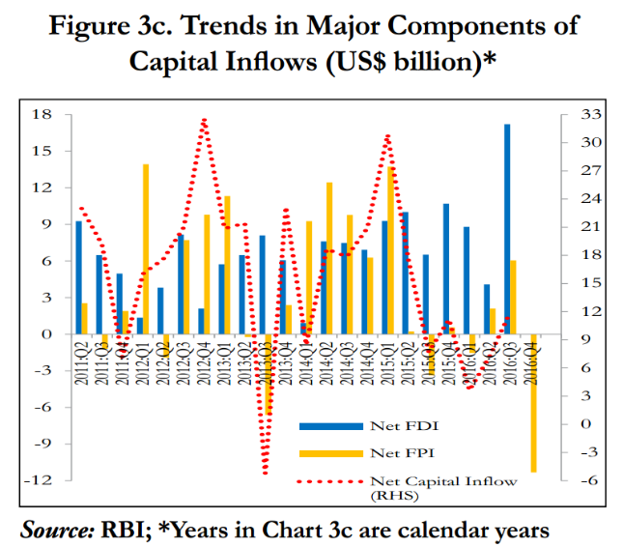








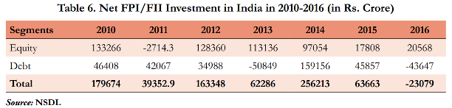
Current Account DEFICIT
चालू खाता घाटा
TRADE DEFICIT
1st time since 2008; 1) pulling out for higher returns in AE! 2) before Trump put some tax on them!

Slide 12
Current Account DEFICIT
चालू खाता घाटा
TRADE DEFICIT
46k cr. Budget 2017
[minus what we loan to Nepal, Bhutan*]
H1-2016
H1-2016
(TBS-NPA)

Slide 13
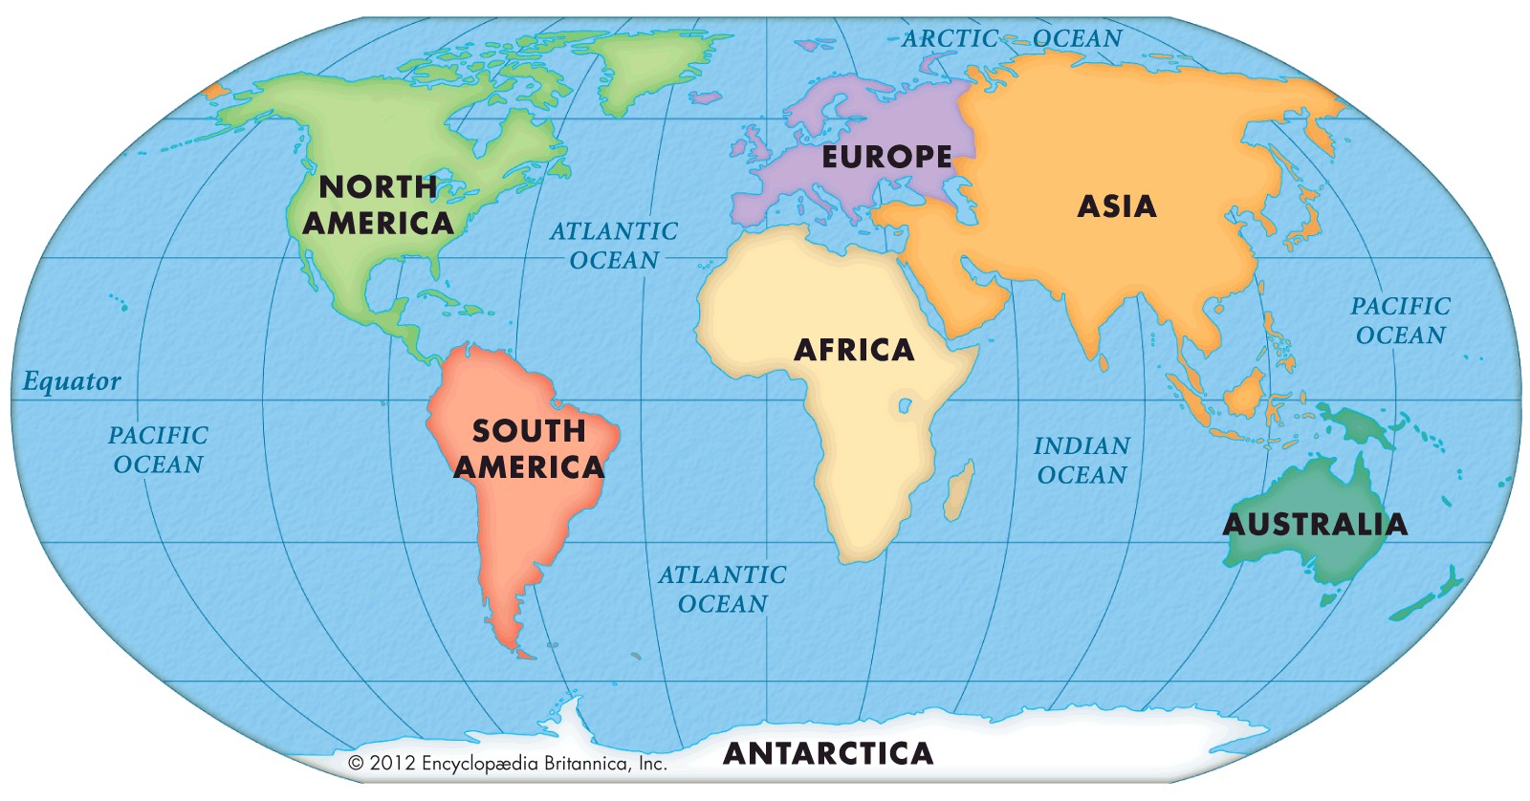





RBI’s ECB Framework 2015
Maturity Period
Rs: 5 years
Foreign currency: 10 years
Eligible borrowers
all except negative list i.e. Real estate, capital markets etc.(Small list)
Eligible Lenders
Regulated financial institutions, sovereign wealth funds, pension funds, insurance companies, etc.
Notes:
Rate- @prevailing market conditions

Slide 14




World Bank (5)->Intl. Finance Corporation (IFC), Washington -> to help private companies in 3rd world
Masala Bond
“Offshore Rupee bond”
Maharaja Bond
“Rupee bond in Domestic market”
IFC: Finance to Indian Company
Rupee repayment
IFC backed = “AAA” rating, so don’t have to pay high interest
Notes:
World Bank
Masala Bonds
Offshore rupee bonds
15 years tenure
Rs.110 billion worth bonds sold
11 pvt cos in India given finance
Maharaja Bonds
Issued within India's domestic Capital market
Rupee denominated
Tenure: 5 years, 10 years

Slide 15
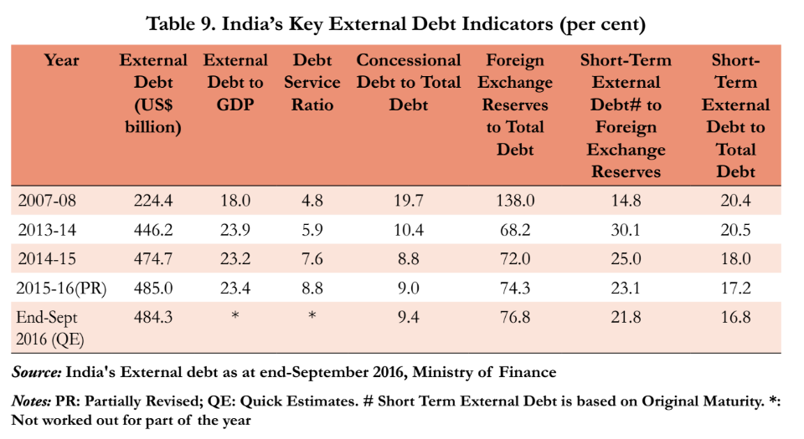
“International Debt Statistics 2017” by World Bank
India’s External debt Composition We are “less vulnerable nation”, Forex Reserve sufficient to cover 77% of debt.
Tenure wise
Sector wise
Long term (83%)
Private (80%)
Currency wise
Dollar > Rs > SDR > Yen

Slide 16
Current Account DEFICIT
चालू खाता घाटा
TRADE DEFICIT
H1-2016
H1-2016

Slide 17

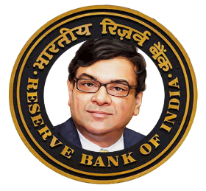



Foreign currency non-resident deposits (B-Banks)
2013: $1= reaching Rs.70, so I need to bring more dollars in India to prevent further fall ☹
@Banks: Offer NRIs more interest. I’ll give you 3.5% subsidy, but you’ve to give me those dollars
Q3-2016 Redemption. Critiques: bcoz in 80s-90s such schemes would create crisis so again 1) RBI will go bankrupt 2) exchange rate destabilize 3) Rajan/Urjit Patel shd be kicked out of the jobs [theHindu columnists: “RBI gov are dumb, only we know how to run RBI!!!”.]
But, RBI had sufficient forex reserve [380 Bn-> FCNR ~30 Bn only. ] so no crisis
Fixed Deposit (Dollars)
Tied with LIBOR (London Interbank Offered Rate) + __%

Slide 18
NEXT
Convertibility
Forex Reserve
Exchange Rate
Sterilization

Slide 19


Stage #1: जरूरत, the requirement
Buy crude oil & gold
Foreign Uni. Admission
Buy Indian mangoes...
Pay for outsourcing
FDI, FPI
$1
Rs.40
Exchange Rate

Slide 20
Stage # 2: गरज, the desperation
$1
Rs.40
$1
Rs.60
More oil & gold imports
Abroad higher education

Slide 21

Balance of Payment IF NEGATIVE
Current
Capital
$-100
$ +51
BOP
$ -50
Error & Omission
$ -1

Slide 22

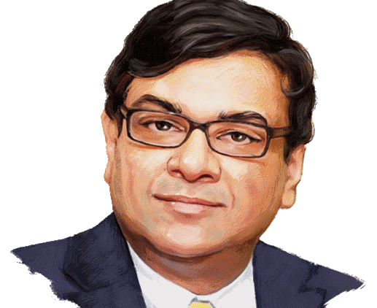


Stage #3: सनक, the obsession
Ruko bhai…
$1
Rs.90
$1
Rs.60
More imports
More foreign education…

Slide 23
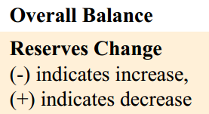
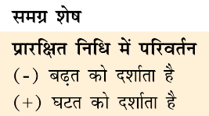

Balance of Payment IF NEGATIVE
Current
Capital
$-100
$ +51
BOP
$ -50
Error & Omission
$ -1
Reserve Change
$ +50
NET BOP
00
1991
RBI did not have sufficient reserve to pay for “imports”
IMF loan with Gold pledging
LPG Reforms
BoP crisis

Slide 24
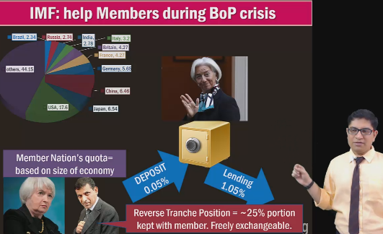


India’s forex reserve consists (China highest: 3 trillion, India ~380 bn)
Held in Foreign treasure Bonds- most preferred US
1st largest China (~1.25 trillion)
India not in top-10
SELF Study LINK
Foreign Currency Assets ($350 Bn)
Gold ($20bn)
IMF’s SDR ($1.5bn)
SDR’s Reverse Tranche position ($2 bn)
Notes:
A certain proportion of a member country's quota is specified as its reserve tranche. The member country can access its reserve tranche funds at its discretion, and is not under an immediate obligation to repay those funds to the IMF. Member nation reserve tranches are typically 25% of the member's quota.

Slide 25
UPSC-2013
India’s foreign exchange reserve includes:
Foreign-currency, SDRs and LOANS from foreign countries
Foreign-currency, gold and SDRs (RIGHT)
Foreign-currency, SDR, LOANS from the World Bank
Foreign-currency, gold, LOANS from the World Bank

Slide 26
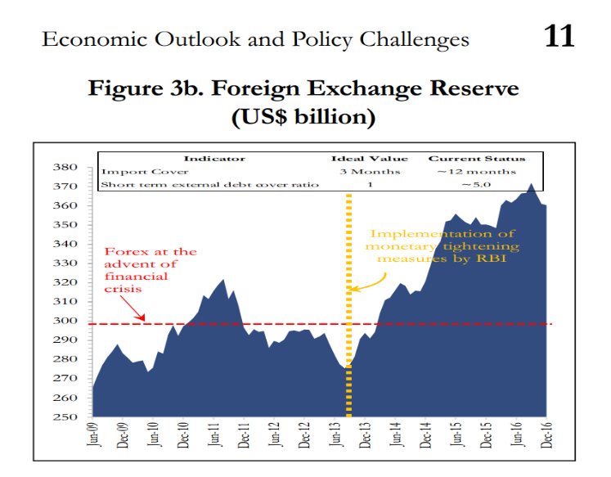

RBI has accumulated Forex reserve..
Declines
By Valuation of Gold price
By RBI intervention (selling $)
Rises
Valuation of Gold
Capital inflow >> CAD =RBI intervention (buying $)
RBI FCNR swap

Slide 27
Mock Question
A: Despite having no current account surplus, India has sizable foreign exchange reserves.
R: RBI Intervention in the foreign exchange markets is the general reason behind accumulation of large forex reserve.
Both correct, R explains A

Slide 28
Find correct statement, about RBI’s foreign exchange reserve,
Gold is the third largest asset in terms of value, in RBI’s forex reserve.
If India’s capital account surplus gets bigger than the current account deficit, then RBI’s forex reserve will increase
Both “A” and “B”
Neither “A” nor “B”

Slide 29

Fixed Exchange Rate Regime
I’ll decide exchange rate
Forex dealer must abide.
If you can’t get @that price, come to me!
$1
Rs.10
$1
Rs.15
“Devaluation”

Slide 30
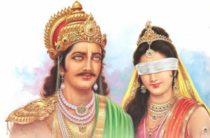
Floating Exchange Rate
I’ll not interfere. Let market forces decide
$1
Rs.10
$1
Rs.15
“Depreciation”

Slide 31
Exchange rate Regime
Regime
Who decides?
Fixed
RBI
Devaluation
Managed Float
Market
Appreciation
Rupee Strong
Rupee Weak
Revaluation
Floating
Market
Appreciation
Depreciation
Depreciation
India has “Managed Float” Post 1991.
I interfere only in case of extreme volatility. We don’t have any target exchange rate.

Slide 32


(Manipulated) Exchange Rate Regime
$1
3 RMB
Even if market forces want Yuan to get stronger, I’ll not let it be…
$1
6 RMB
“Undervalued”, to help exporters

Slide 33
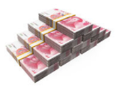
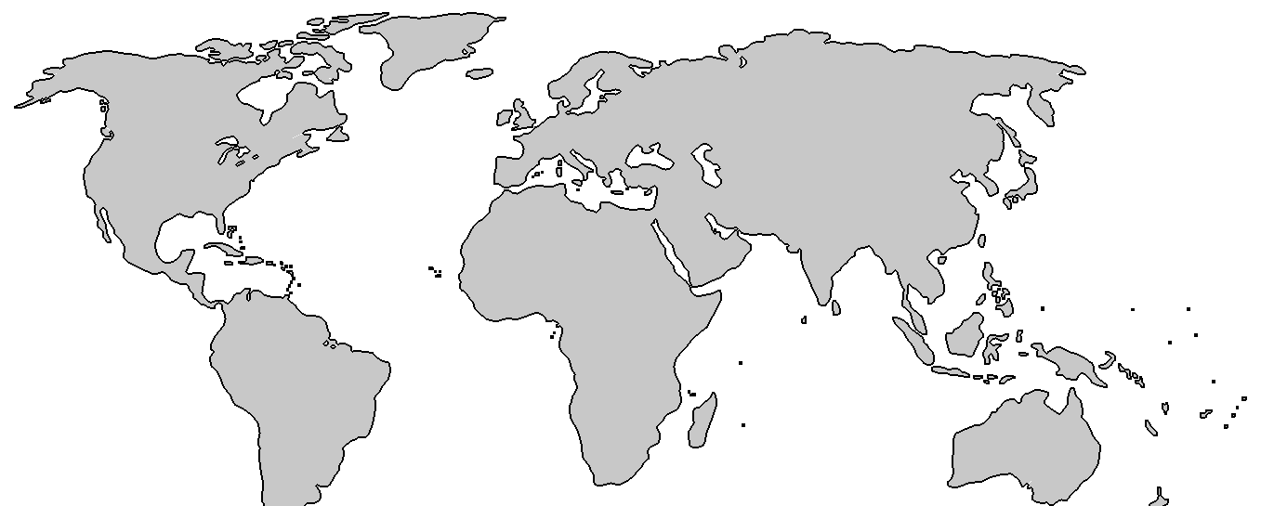


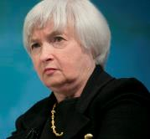

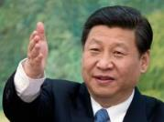
But China keeps yuan (Renminbi) undervalued, HOW?
$$ shortage in
Chinese Forex market
$1 = 6 Yuan
Good for exports
Keep printing Yuan
Keep investing incoming $$ back to US treasury bonds. China’s Forex reserve = $ Trillion dollars

Slide 34

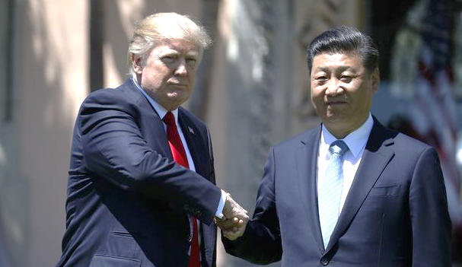
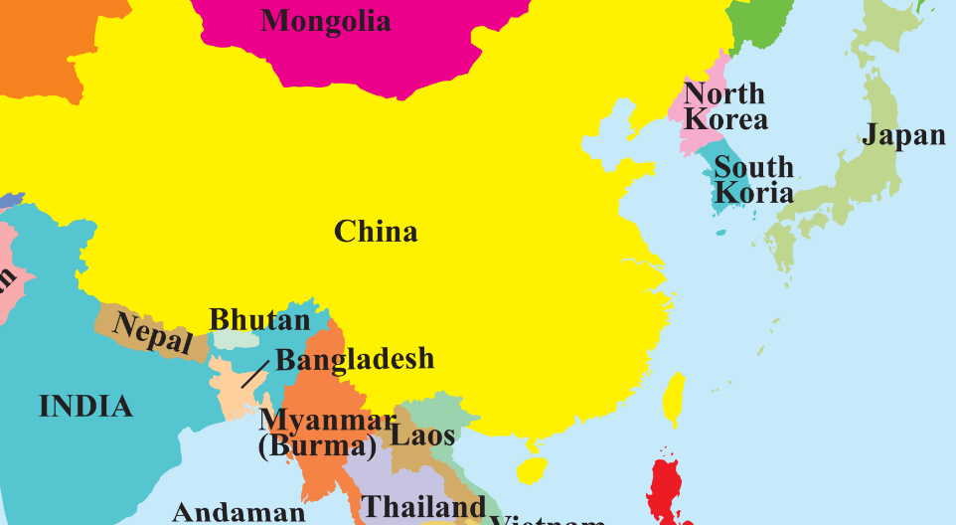
@GSHSEB authors correct the spelling in std.12 Geography textbook
11th Jingping मेरा नाम,
Currency manipulation मेरा काम,
PS: इसे “शाहीन के पंजे” कहेते है!
oww..my hand is hurting ☹
US Treasury report puts them under ‘watch list’. Not tagged “Manipulator”, since Trump wants support against N.Korea
Taiwan (T$)

Slide 35
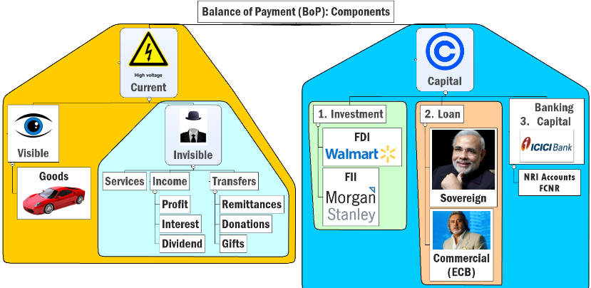
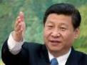
Thanks to currency manipulation, China’s Balance of Payment (2014)
Export (undervalued yuan, labor exploitation)
Import: restrained (IT/Pharma) ▼
US bond purchase
(-)
Remi. 2nd largest
Current Account surplus (+210 Bn)
Capital Acc. DEFICIT -96 Bn.

Slide 36

Since China’s BoP is positive
Current
Capital
$+210
$ -96
BOP
$ +114
Error & Omission
$ -0
Reserve Change
$ -114
NET BOP
00
Purchase $
Cumulatively, Largest Forex in the world: ~3 trillion$

Slide 37
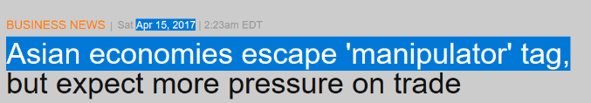
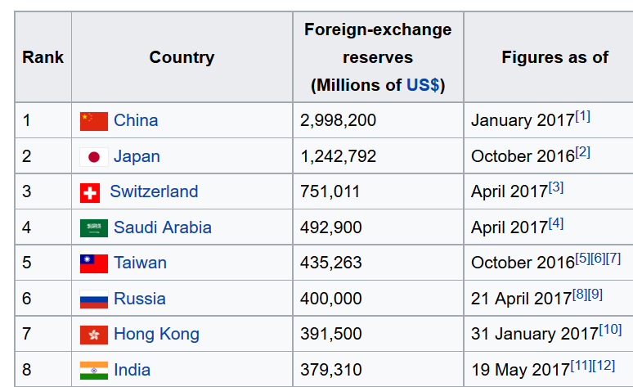

How can
“ittu sa desh” Taiwan have bigger Forex reserve than India!!?

Slide 38

India vs. others
Exchange rate regimes
China, Japan and Korea business enterprises grew by keeping local currency undervalued.
But later on paid negative consequences. [keep printing local currency-> inflation.]
RBI does not manipulate the exchange rate up or down, But intervenes in the situation of extreme volatility
But we should target forex reserve $750bn -1 trillion: hard & soft power in international relations.
Hence Make in India, Skill India, foreign trade policy…
हिन्दुस्तानियो
फोरेक्ष जमा करना
हम से सीखो!

Slide 39

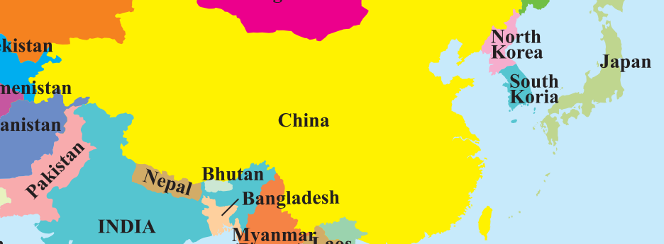

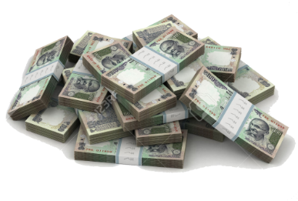


Currency SWAP agreements (in Emergency we’ll help each other)
“SWAP” is a derivative.
Local currency with other party’s Dollar Reserve, during crisis.
India Japan: upto 15 billion

Slide 40
NEXT
Convertibility
Exchange Rate
Sterilization
Forex Reserve

Slide 41

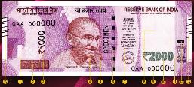

(Domestic Monetary Policy) against Inflation control: OMO

Slide 42


India’s Balance of Payment…
Current
Capital
$ -10
$ +90
BOP
$ +80
Error & Omission
$ -0
Reserve Change
$ -80
NET BOP
00
$ absorbed in Forex reserve…but then
Domestic Currency supply increased…
Demand pull
INFLATION ☹

Slide 43
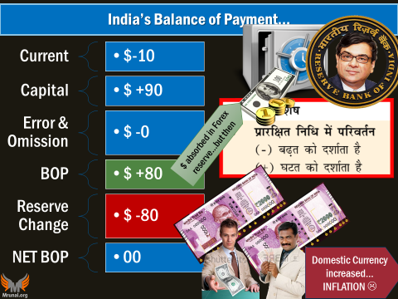

Then what to do?
Sell bonds, to absorb domestic component of currency.
“Sterilization”
Notes:
Alternatively,
Allow Indians to invest more abroad. To take away domestic currency->$

Slide 44
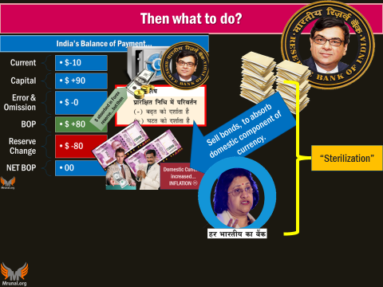
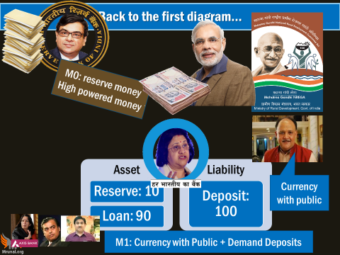
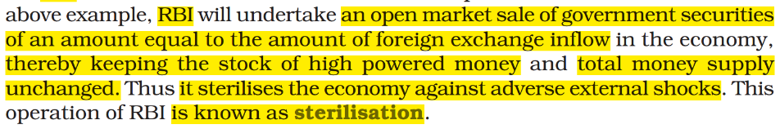

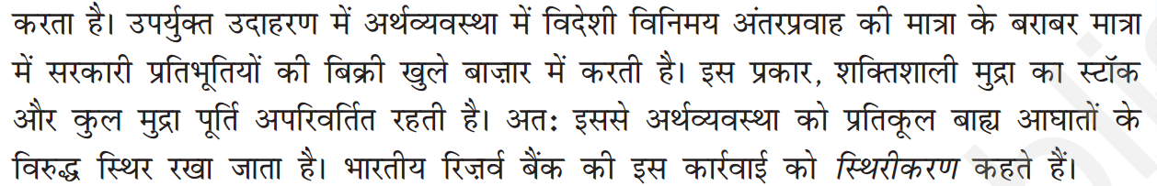
NCERT Class 12 Macro Ch.3: Money and Banking

Slide 45
Mock question for Prelims
If RBI doesn’t carry out ‘sterilization’, which of the following outcomes will happen definitely?
Deflationary spiral will start.
RBI’s forex reserve will deplete.
Current Account deficit will rise.
Total money supply will rise.

Slide 46
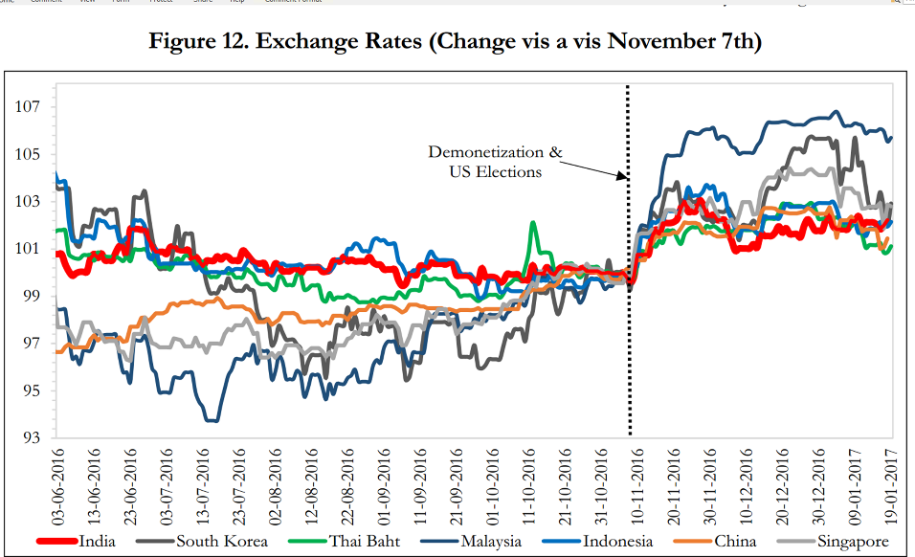
Impact of demonetization on Exchange rate?
Dem = modest impact but since Trump election= FPI exit from India (recovery, tax)..hence
Without demonetization, we could be here?!
Without Trump election we could be here!?

Slide 47
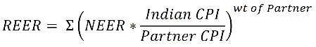
$1=60, $1=70…but are we trading only with US?
Effective Exchange Rate (Geometric Average of 6, 36)
Nominal (NEER)
Real (REER)
Wt. avg depending on trade volume
(CPI) Inflation adjusted, RBI Calculates

Slide 48
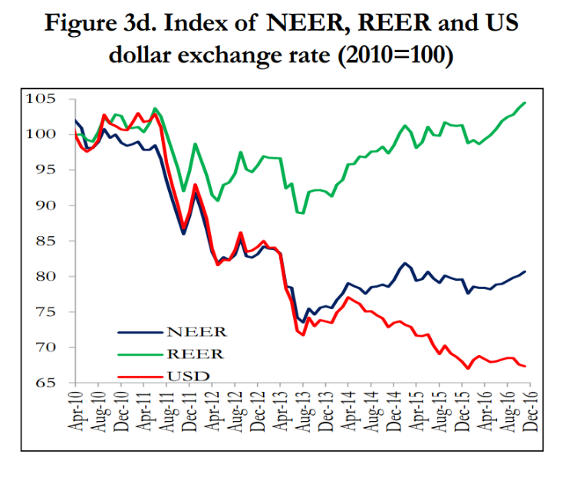
REER >100 = “overvalued” currency
REER:
Rupee Appreciated
NEER:
Rupee ‘mostly’ depreciated
Dollar:
Rupee depreciated (US election..flight)
Notes:
REER > 100 means overvalued
<100 means undervalued ($1=6 Yuan)

Slide 49
NEXT
Convertibility
Exchange Rate
Sterilization
Forex Reserve
CURRENT
CAPITAL

Slide 50
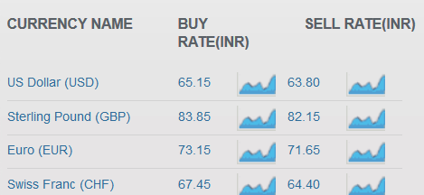
Forex dealers have to register with RBI (incl. Banks)
Old book (MRP)
Customer Buy @60% MRP
Customer Sell @30% MRP
Only then bookstore will make profit!
Difference between
buying and selling price = ‘profit’

Slide 51
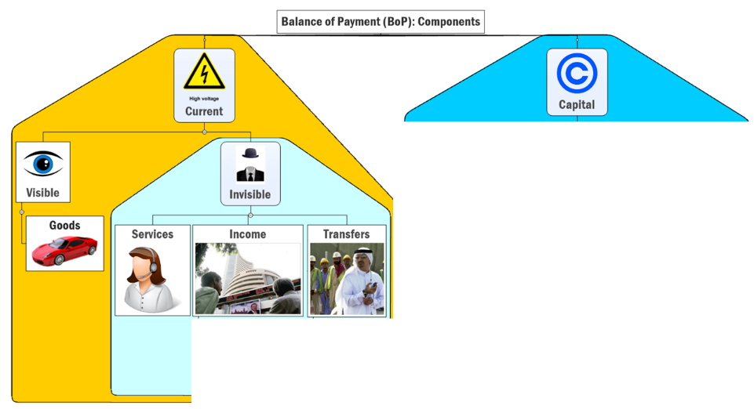
Central Bank registers dealer & decides Currency Convertibility
73
99
FEMA
FERA: Foreign Exchange Regulation Act
All “dealers” have to register with RBI -> “Authorized Dealers”
Convertibility norms on current and capital transactions.

Slide 52

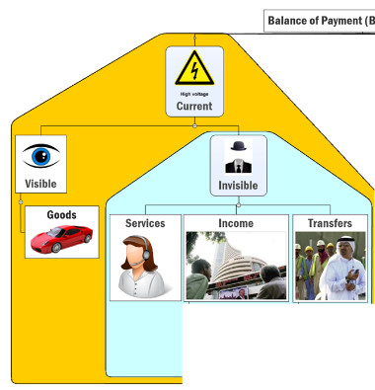




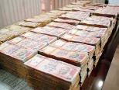



(in theory) India rupee fully Convertible for current account

Slide 53
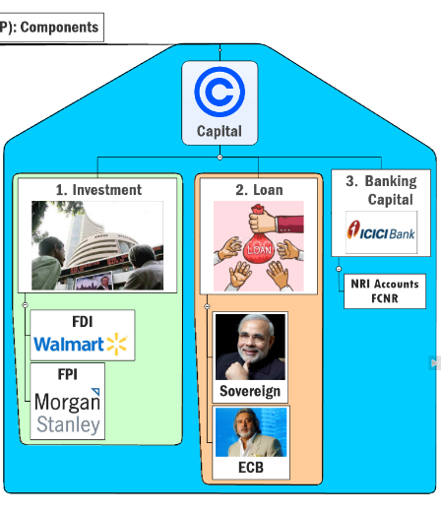



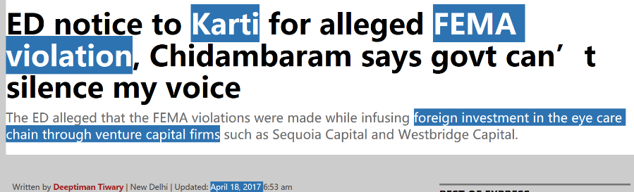

India rupee is NOT fully Convertible for CAPITAL account
ECB
1 Billion ($$)
Aviation sector Quota
$1 Billion
Individual Company
$300 Million (long term)
+RBI permission
IF unrestricted movement
Loan Repayment, “EXIT” (FDI/FPI)
Difficulty for RBI to control volatility in Exchange rate
finMin-> Dept of Revenue->ED -> FEMA & PMLA

Slide 54
Mock Question for Prelims
Find correct statements about Enforcement Directorate (ED):
It enforces FEMA Act
It enforces Prevention of Money Laundering Act
It falls under the administrative control of the Department of Economic Affairs.
Answer Choices
a) Only 1 and 2 (b) Only 2 and 3
c) Only 1 and 3 (d) all of them

Slide 55

(In reality) RBI’s Liberalized Remittance Scheme (2004)
Individual: Max. $2.5 lakh you can take out per year from India.
Use it for either way. E.g. Current [buying foreign university ‘degree’] OR Capital: USA share market. BUT not for setting up co. hence BigB, Ash et al investigated for Panama Papers.

Slide 56
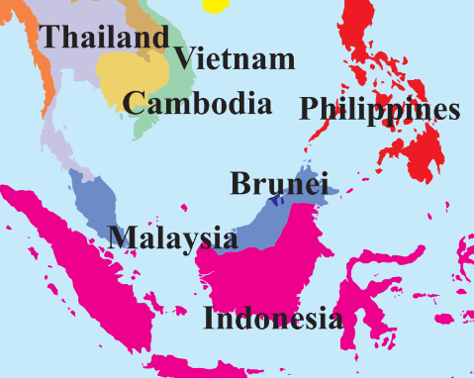
Before 1997, East Asian “Tiger” economies: undervalued currencies, full capital account convertibility to get FDI
1997
Auto, steel companies bankruptcy filed
Flight of Foreign Investors’ “HOT MONEY”
$1 = 2000 Indonesian Rupiah
$1= 18,000 Indonesian Rupiah
Consequences
Central Banks Forex depleted
Inflation (Crude Oil), Political instability

Slide 57
GDP growth rate (1998)
Full / very liberal capital account convertibility

Slide 58
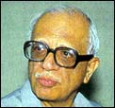
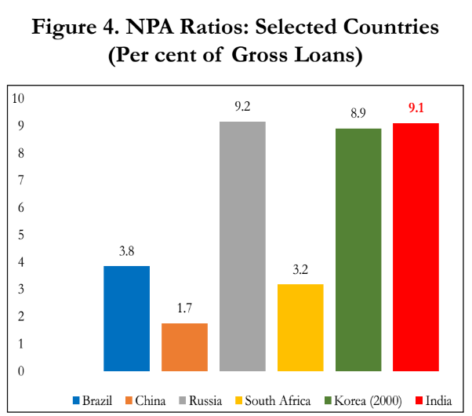
S.S. Tarapore Committee (1997)
Preconditions for Capital Account C. | 2017-18
Enough forex to sustain 6 months’ import | Yes. Even more ($380 bn)!
Fiscal deficit: 3.5% of GDP | 3.2 %
Inflation avg 3-5% (three years) | Statutory 2-6%
Interest rates decontrol | Not for agro.
CRR: 3% | 4%
Bank NPA 5% of their assets | ☹☹☹
PSB:
12%

Slide 59
Prelims: 1996
full capital account convertibility of Indian rupee is being advocated because:
It’ll stabilize rupee exchange value against major currencies of the world (NOT Necessary. E.g. War, QE, FT)
it will help to promote exports (CURRENT)
it will help India secure loans from the world financial markets at attractive terms. (NOT Necessary)
it will attract more foreign capital inflow in India.

Slide 60


Economy: 6 pillars + theory + current + BES17 (pre cum Mains)
1.Banking, Fin, Insur.
6.HRD
2.Budget
3.BoP & Intl. Trade
4.Sectors
5.Infra
V1:c3,4
V1:c2,3, 6,9,11(GST),12,13
V1c:5
V1c:7,11(Agri)
V1c:10
v1c:12, 14; Budget^Rail
BES173: theory, current
BoP-Current
BoP-Capital
Orgs
Survey Ch.5

